Slide 1
THE IMPACT OF TRADITIONAL GENDER ROLES ON WOMEN'S EMPOWERMENT IN AFRICAN COMMUNITIES

Slide 2
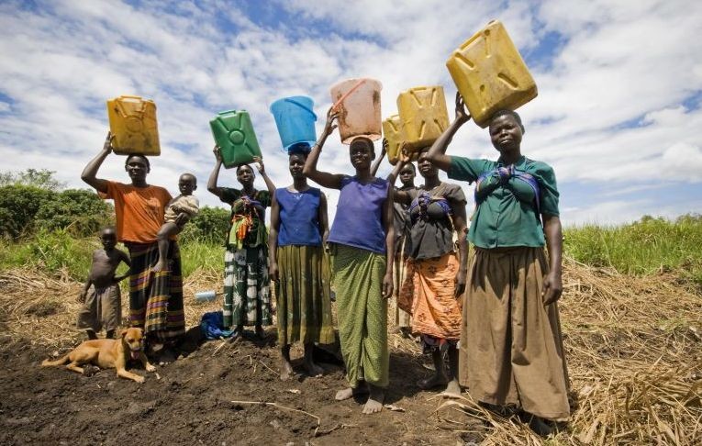
Traditional gender roles often confine women to domestic duties. In many rural communities, women are primarily responsible for household chores and caregiving, which limits their opportunities for education and economic advancement.

Slide 3
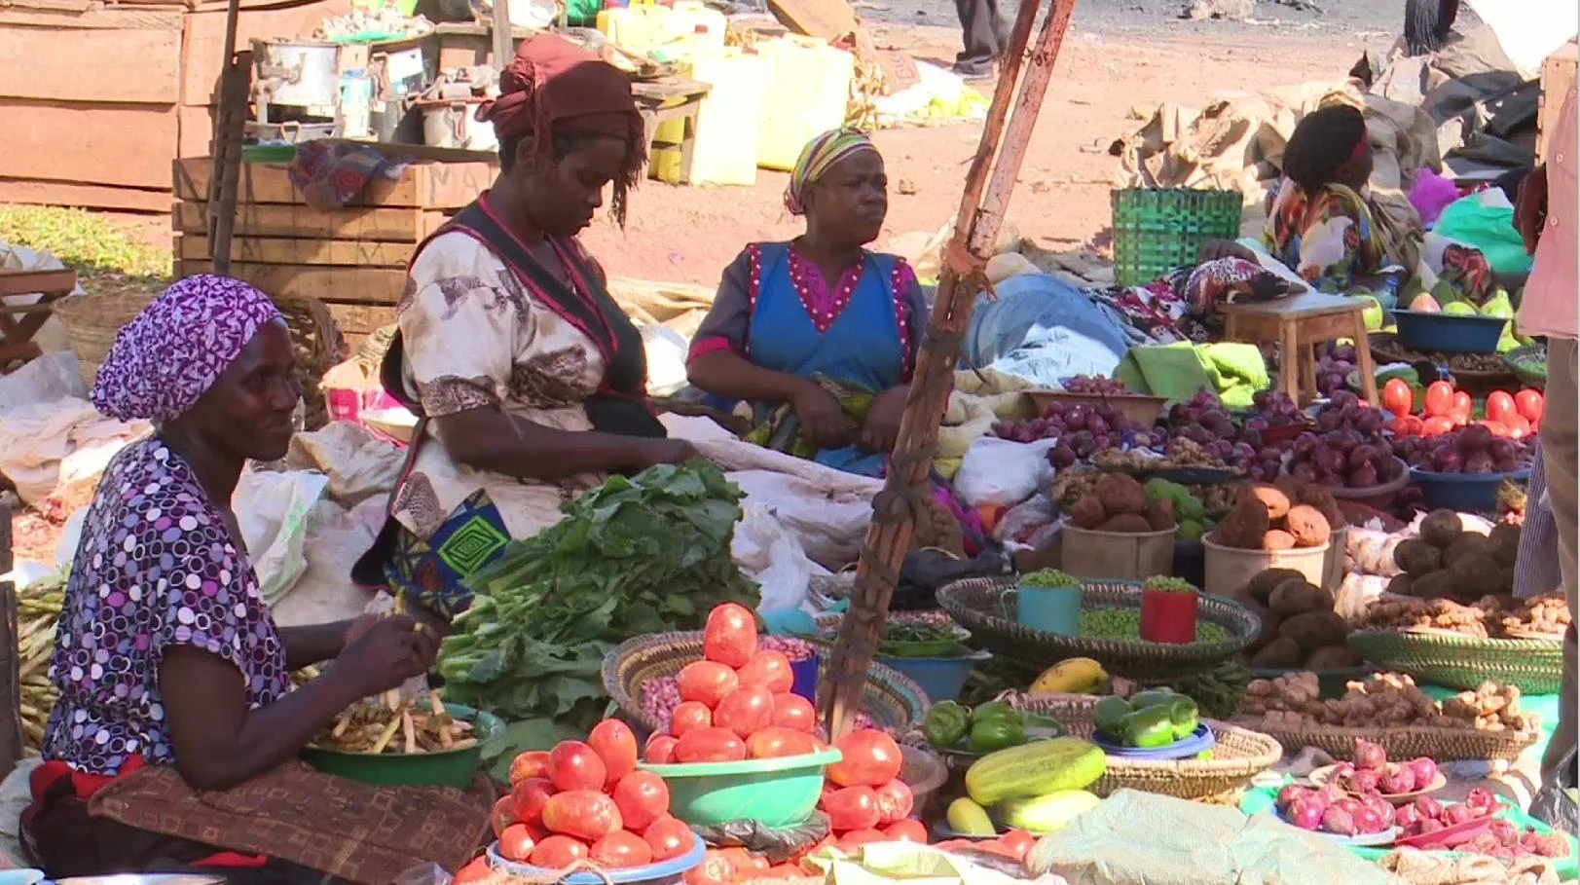
Despite facing barriers, many women are finding ways to contribute economically through informal markets. This entrepreneurial spirit is crucial for their empowerment and financial independence

Slide 4
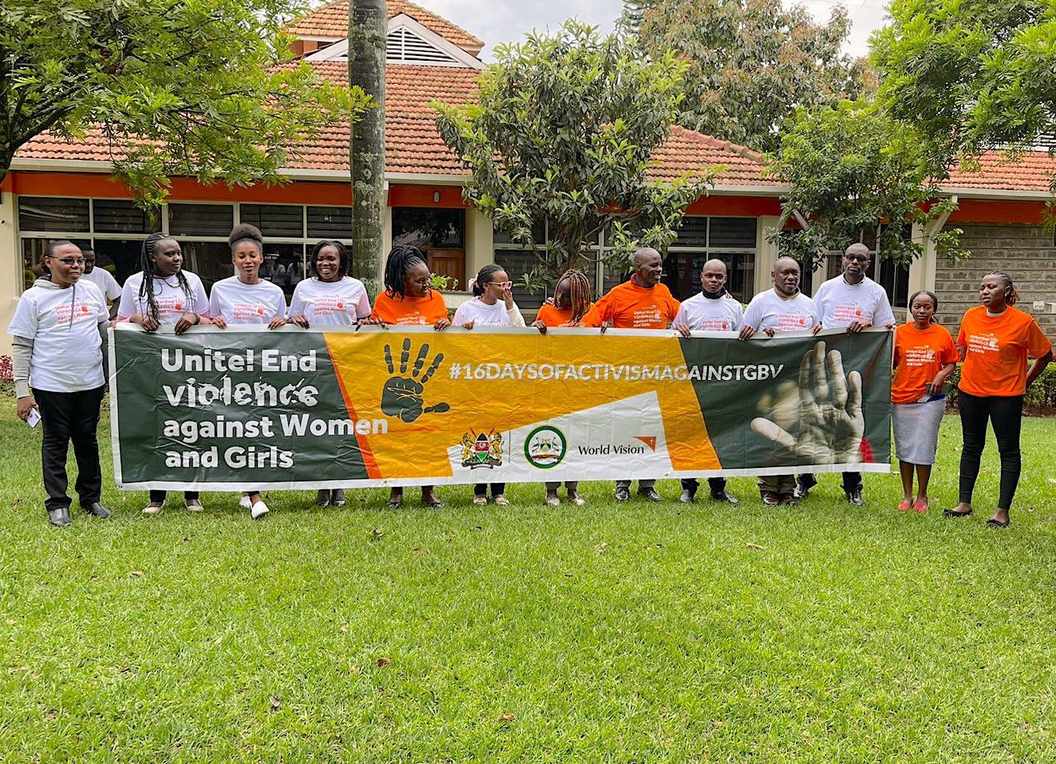
Gender-based violence remains a significant issue, often rooted in traditional practices and societal norms. Support groups and advocacy organizations are working to address and combat this violence.

Slide 5
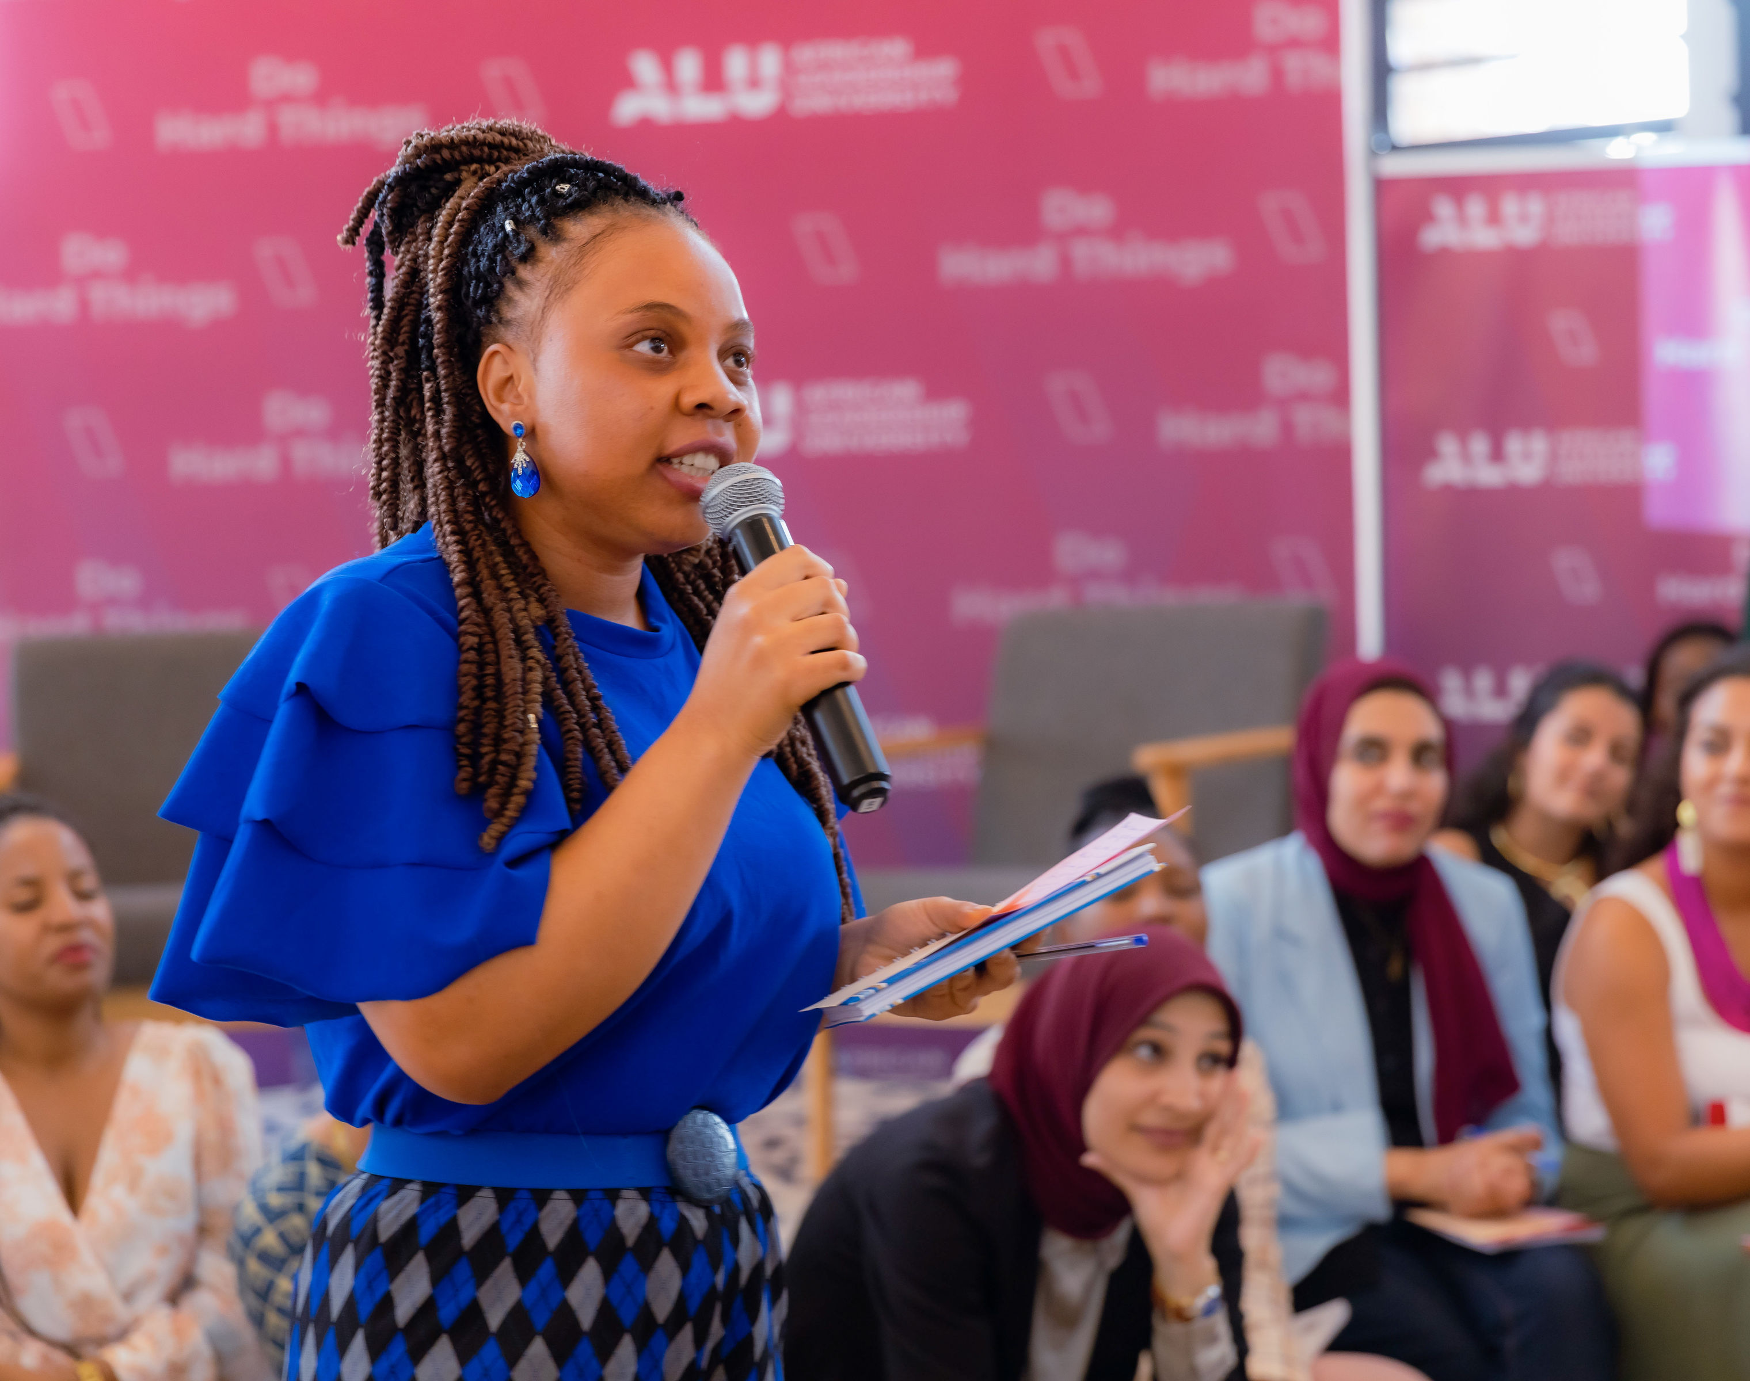
Emerging female leaders are challenging traditional norms and advocating for gender equality. Their leadership roles are gradually changing perceptions and opening doors for other women.

Slide 6
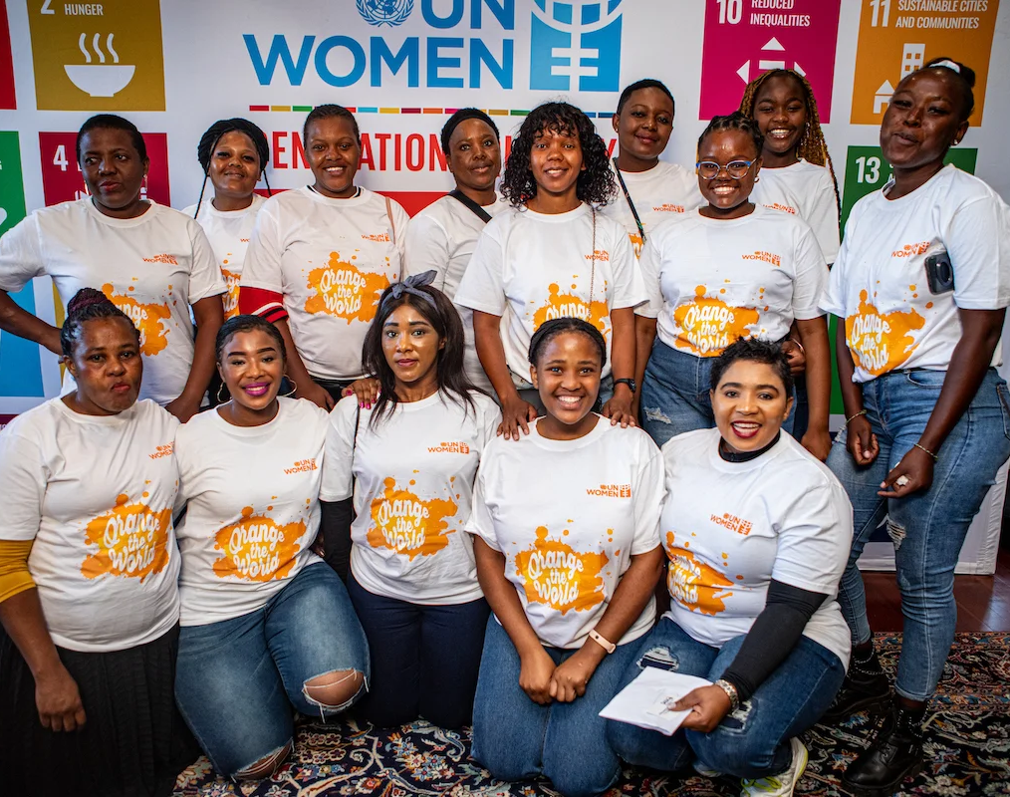
Community workshops and educational programs are promoting gender equality and challenging traditional roles. These initiatives aim to empower women and foster a more inclusive society.

Slide 7

Many women are defying traditional constraints and achieving significant success in various fields. These success stories inspire others and demonstrate the potential for change when barriers are overcome.

Slide 8
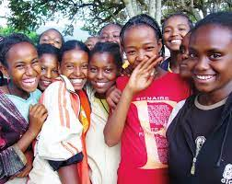
Investing in the education and empowerment of young girls is crucial for the future. Mentorship programs and support systems are helping to shape a new generation of leaders and change-makers.

Slide 9
The end thank you!

